Slide 1
GEN AI 1.0

Slide 2

Course
From Basics to Big Data Analytics
14-09-2023

Slide 3



About me
Alejandro Marchán
Data Engineer en StratioBD
Ingeniera Informática en la UC3M
3 años en DOMINION GLOBAL
2 años y medio en Stratio:
1 año y medio en ECI (Integración de Producto)
1 año en Stratio Scanner (Desarrollo de Producto)
linkedin.com/in/alejandro-marchan-alvarez
github.com/AlejandroMarchan

Slide 4
Getting Started: Setup and Installation
Python Refresher
Introduction to Spark
Spark Data Processing
Spark SQL
Spark Performance Tuning

Slide 5
1. Getting started: Setup and Installation

Slide 6
Getting started: Setup and Installation
Cloning the course GitHub Repository
Open the terminal (CTRL + ALT + T)
Execute the following command:
git clone https://github.com/amarchan-stratio/spark-course
Navigate to the folder spark-course/
Open the GitHub repository in your navigator
Follow the Getting Started instructions

Slide 7

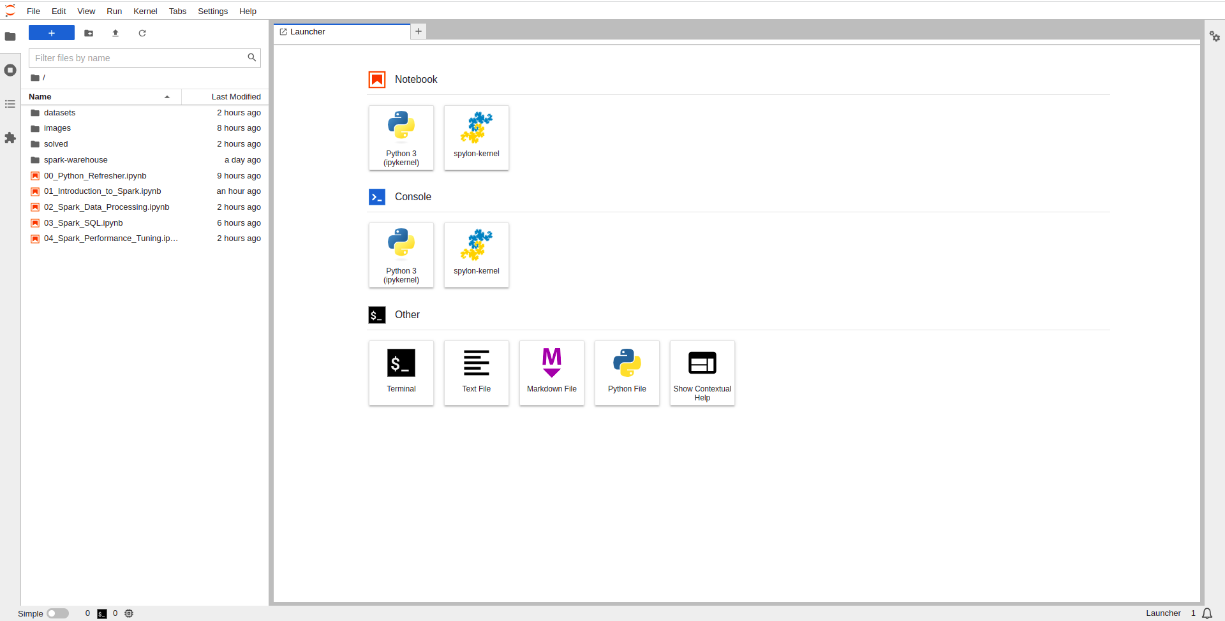
Getting started: Setup and Installation
Once everything is installed you should see something like this…

Slide 8
2. Python Refresher

Slide 9


Python Refresher
Don’t remember Python? Don’t worry…
The Jupyter Notebook 00_Python_Refresher.ipynb contains
a brief refresher of the basics of Python. Such as:
Basic Python syntax
Data structures: lists, dictionaries, sets, and tuples
List comprehensions and lambda functions
Modules and packages
Exercises
If you'd like more practice with Python, I recommend checking out HackerRank. Earning the 5-star Python badge there helped me a lot! Also follow me there if you want 😃

Slide 10
3. Introduction to Spark

Slide 11

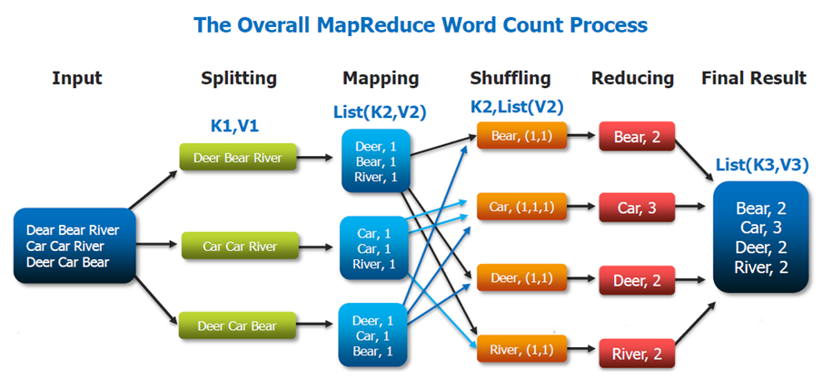

Introduction to Spark
What is Apache Spark?
Apache Spark is an open-source distributed computing system that provides an interface for programming entire clusters with implicit data parallelism and fault tolerance.
It was built on top of Hadoop MapReduce and extends the MapReduce model to efficiently use more types of computations, including interactive queries and stream processing.

Slide 12
Introduction to Spark
Key aspects
Framework for distributed data computing.
Designed to be executed in large scale clusters with lots of data!
Run faster than MapReduce, up to 100x due to memory (RAM) usage.
More functions than just Map and Reduce.
Multiple APIs, multiple programming languages:
Core, SQL, Streaming, GraphX, ML, MlLib, Structured Streaming, …
Scala (native), Java (native?), Python, R.
Runs everywhere:
Standalone, YARN, Mesos, Kubernetes, AWS, ...

Slide 13
Introduction to Spark
Key aspects
Fault tolerance (RDD).
Easier resource managing.
Reusable data: caching.
Code control and analysis (DAG).
Generic programming patterns: the same code can run in local mode or 100’s of executors.
Lazy evaluation: transformations and actions.

Slide 14

Introduction to Spark
Spark Architecture
Driver Program: Think of this as the "master" of the application. It's where your Spark application starts and where the final results are collected.
SparkContext (SC): This is like the "brain" of your Spark application. Once initialized, it coordinates tasks and keeps a connection with the Spark cluster.
Cluster Manager: This can be likened to a "job dispatcher". It's not part of Spark per se, but Spark can work with several of them, like Apache Mesos, Hadoop YARN, Kubernetes, or the built-in standalone manager.
4. Executors: These are like the "workers". Each executor:
Runs on a node in the Spark cluster.
Is responsible for executing the tasks assigned by the driver program.
Stores data in its memory for quick access.
5. Tasks: These are the "actual work" that needs to be done.
When you write a Spark application, the driver breaks down the operations into tasks that are sent to the executors.

Slide 15
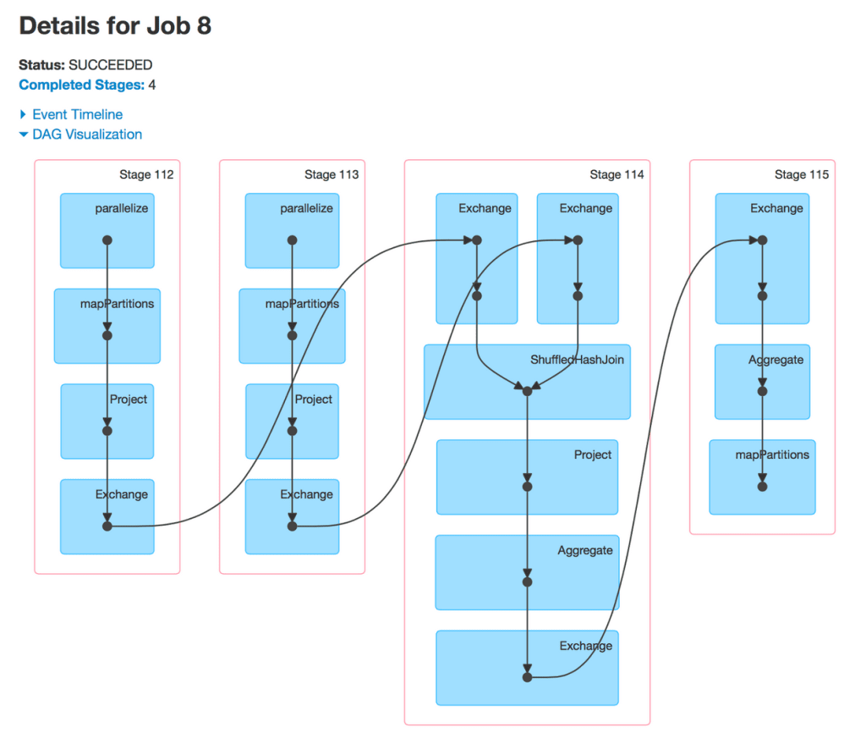
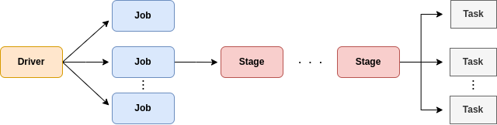
Introduction to Spark
Jobs, Stages, and Tasks
Job: A complete computation, which can be a single action like count() or saveAsTextFile().
Stage: Jobs are divided into stages. A stage is a set of transformations on data that can be executed in parallel (e.g., filtering, mapping). Stages are divided based on transformations that have wide dependencies (like a reduce) which often involve shuffling data around.
Task: Each stage is further divided into tasks. A task is a unit of work sent to an executor.

Slide 16
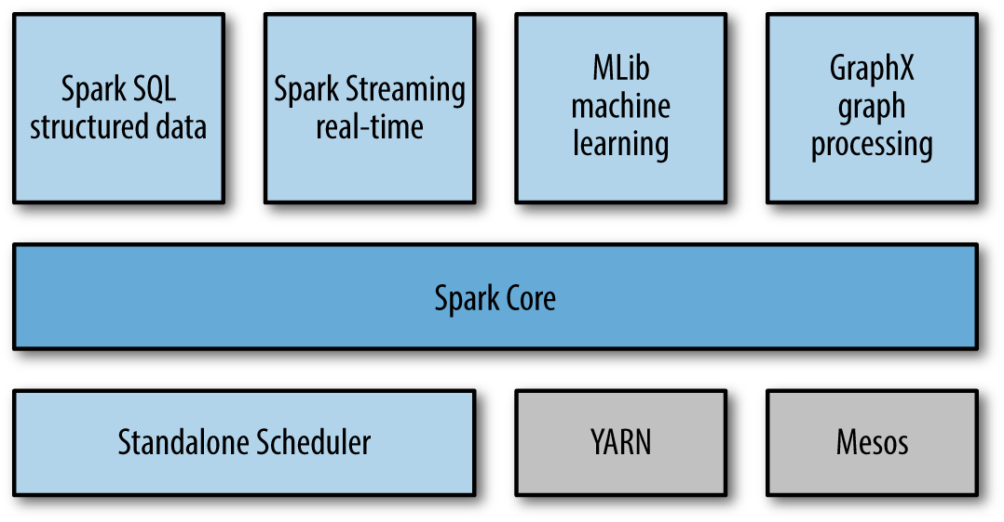
Introduction to Spark
Spark Stack

Slide 17
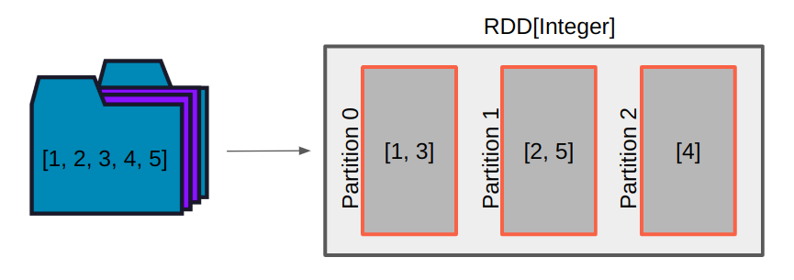
Introduction to Spark
RDDs (Resilient Distributed Datasets)
RDD is a fundamental data structure of Spark. It is an immutable distributed collection of objects that can be processed in parallel. RDDs can be created from Hadoop InputFormats or by transforming other RDDs.
Properties of RDD:
Immutable: Once created, the data they contain cannot be changed.
Lazy Evaluations: Computations on RDDs are lazily evaluated, meaning that tasks are not executed until an action is called.
Fault Tolerant: They track data lineage information to rebuild lost data.

Slide 18
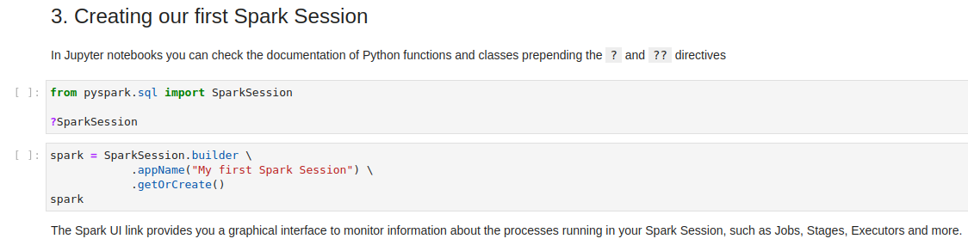
Introduction to Spark
Let’s create our first Spark Session
Jump back into Jupyter Lab to see how…
Open the Jupyter Notebook 01_Introduction_to_Spark.ipynb

Slide 19
4. Spark Data Processing

Slide 20
Spark Data Processing
Transformations and Actions
Transformations
Operations that create a new RDD, usually based on a previous one.
Does not evaluate the expression until an action is called (lazy evaluation).
Spark is able to infer the output type.
You can concatenate multiple transformations, before an action.
Map, filter, groupBy, repartition …
Actions
Operations that evaluates all the transformations defined.
Forces the evaluation to save or use the result data.
Reduce, fold, collect, saveAsTextFile …

Slide 21
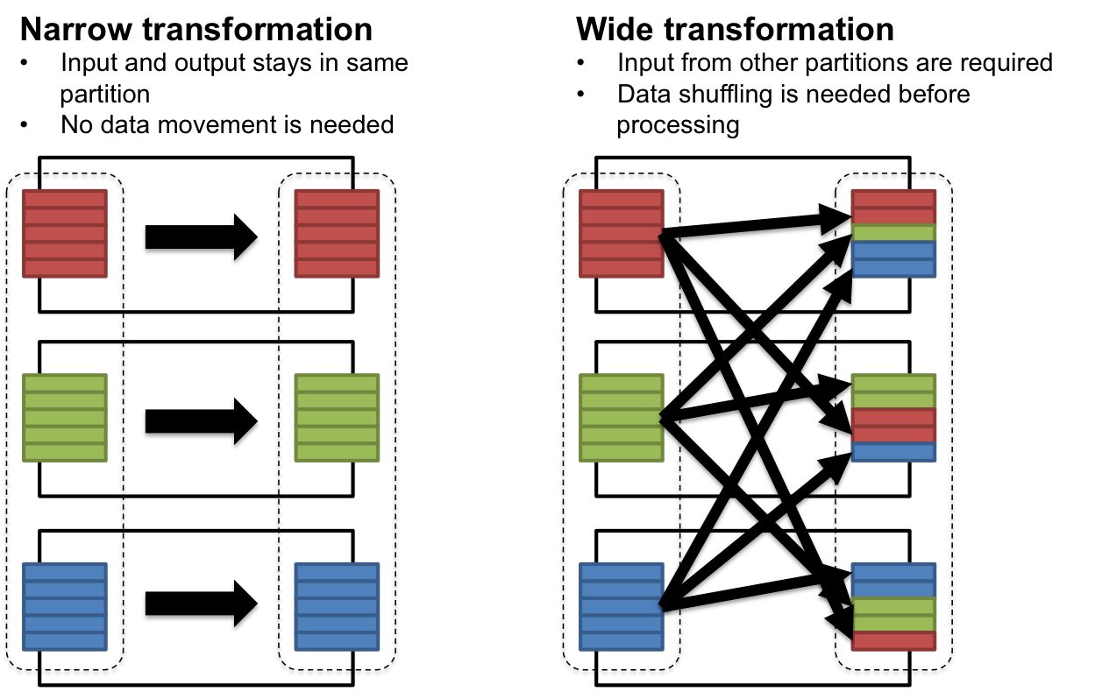
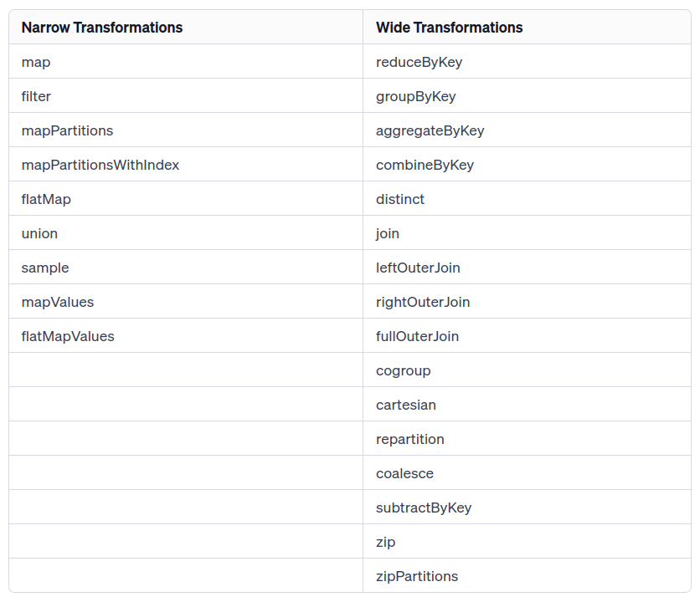
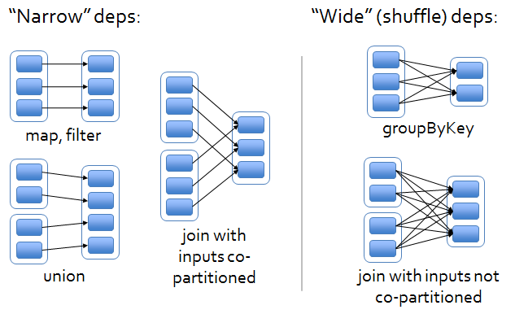
Spark Data Processing
Transformation types

Slide 22
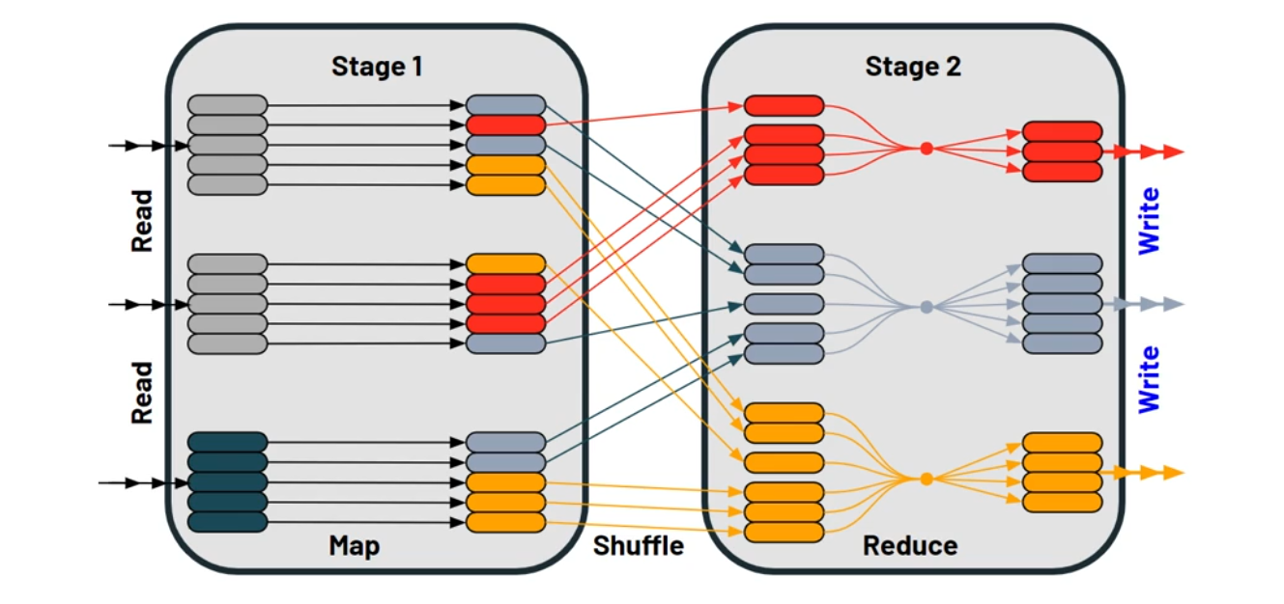
Spark Data Processing
The Shuffling process
It's the process of redistributing the data across the partitions. This can involve reorganizing the data within a single machine or moving data across multiple machines in the cluster. Shuffling can be expensive in terms of performance because it involves disk I/O, data serialization, and network I/O.
Shuffle usually occurs during operations that require data reorganization

Slide 23
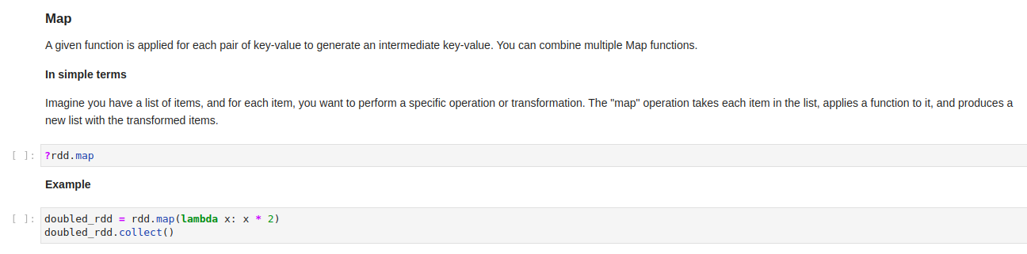
Spark Data Processing
Let’s transform our RDD
Jump back into Jupyter Lab to see how…
Open the Jupyter Notebook 02_Spark_Data_Processing.ipynb

Slide 24
5. Spark SQL

Slide 25
Spark SQL
Difference between RDDs, DataFrames and DataSets.
RDDs (2011):
Distribute collection of Java Virtual Machine (JVM) objects
Functional Operators (map, reduce, filter, etc)
DataFrame (2013):
Distributed collection of Row objects
Expression based operations and User Defined Functions (UDFs)
Logical plans and optimizer
Fast/efficient internal representations
DataSet (2015):
Internally Rows, externally JVM objects
Almost the "Best of both worlds": type safe + fast
Slower than DataFrame, not as good for interactive analysis, especially Python

Slide 26
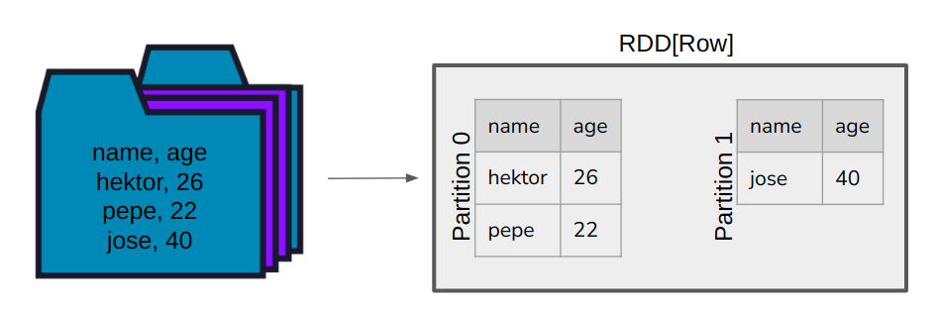
Spark SQL
DataFrames
Distributed collection of Row objects. These objects contain the schema within the data.
Data is organized into columns like a relational database.
The main features of Dataframes:
Catalyst: powers the DataFrame and SQL APIs.
Analyzing a logical plan to resolve references
Logical plan optimization
Physical planning
Code generation to compile parts of the query to Java bytecode.
Tungsten: provides a physical execution backend which explicitly manages memory and dynamically generates bytecode for expression evaluation.

Slide 27
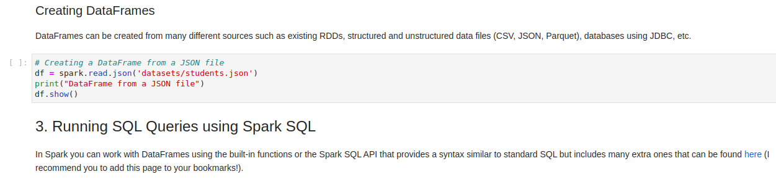
Spark SQL
Let’s create a DataFrame and start running SQL queries
Jump back into Jupyter Lab to see how…
Open the Jupyter Notebook 03_Spark_SQL.ipynb

Slide 28
6. Spark Performance Tuning

Slide 29
Spark Performance Tuning
Caching and Persistence
Caching and persistence are optimization techniques for iterative and interactive Spark computations. They help store intermediate data in memory or more durable storage mediums to avoid recomputing the same information all the time.
When to Cache or Persist?
Iterative Algorithms
Reused Data
Expensive Computations
Frequent Joins with a Small DataFrame
Interactive Analysis
Checkpointing
When NOT to Cache or Persist?
Infrequent Access
Limited Memory
Mutable Workloads
Storage levels
MEMORY_ONLY
MEMORY_AND_DISK
MEMORY_ONLY_SER (serialized)
MEMORY_AND_DISK_SER (serialized)
DISK_ONLY

Slide 30
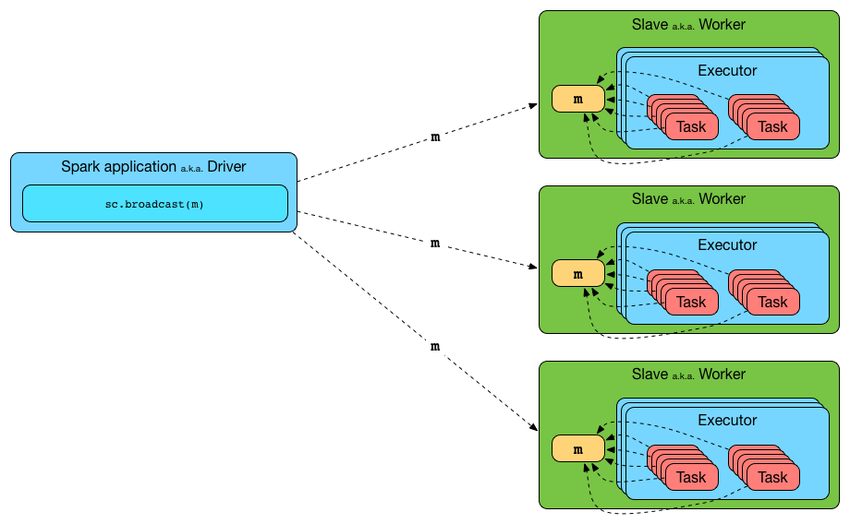
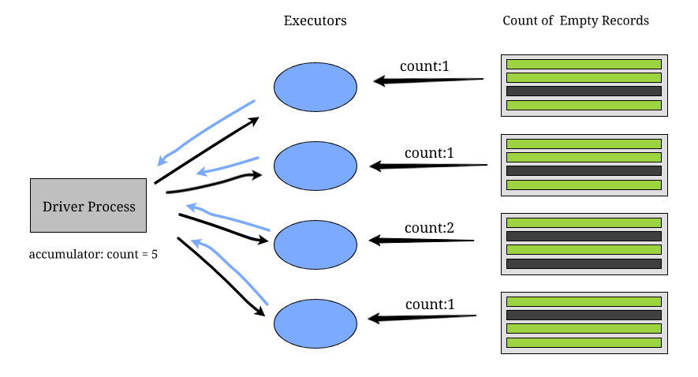
Spark Performance Tuning
Broadcast Variables and Accumulators
Broadcast Variables:
When working with Spark, you might need to send a read-only variable to all the executors. Broadcast variables allow the programmer to keep a read-only variable stored on each executor rather than shipping a copy of it with tasks.
Accumulators:
Accumulators are variables that can only be "added" to. They can be used to implement counters and sums efficiently in parallel. Spark natively supports accumulations of numeric types, and programmers can add support for new types.

Slide 31
Spark Performance Tuning
Partitioning
Partitioning in Spark is a way to distribute the data across the distributed storage or computing nodes. Proper partitioning is essential for distributing computation and for optimizing data shuffling and I/O operations.
When is it useful to partition data and why?
Optimizing Data Locality: When data and the computation is close to each other, the time to fetch the data is reduced, leading to faster task execution.
Optimizing Shuffles: In operations like joins or groupBy, if the data is properly partitioned, the need to shuffle data across nodes can be minimized, leading to performance improvements.
Load Balancing: Proper partitioning ensures that data is evenly distributed across nodes, preventing situations where some nodes are idle while others are overloaded.
Optimizing Joins: When two DataFrames/RDDs are being joined on a particular column and they are partitioned using the same key, the join operation can be optimized since data is already co-located.
Optimizing Data Storage: When saving data back to distributed storage systems like HDFS or cloud storage, partitioning can optimize storage and subsequent read operations. For instance, data can be partitioned by date, so each day's data is in a separate directory.

Slide 32
Spark Performance Tuning
Most common types of Partitioning and When to Use Them
Hash Partitioning: Spark distributes data based on the value's hash code. It's useful when you want to ensure a balanced distribution of data but don't necessarily care about which specific keys go to which partition.
Use Case: When performing a join operation on a key, using hash partitioning on that key for both DataFrames can optimize the join
Range Partitioning: The data is partitioned based on a range of values. This ensures that a continuous range of data values resides in a single partition.
Use Case: When you have ordered data and operations (like sorting), range partitioning can be beneficial.
Bucketing: Specific to DataFrames and used primarily when saving data to storage, bucketing is a form of partitioning where data is divided into a fixed number of "buckets" based on the hash of a column's values.
Use Case: Useful when you have a large dataset that you'll be querying frequently with filters on a specific column. For instance, saving data in buckets based on user ID for a large user dataset.

Slide 33
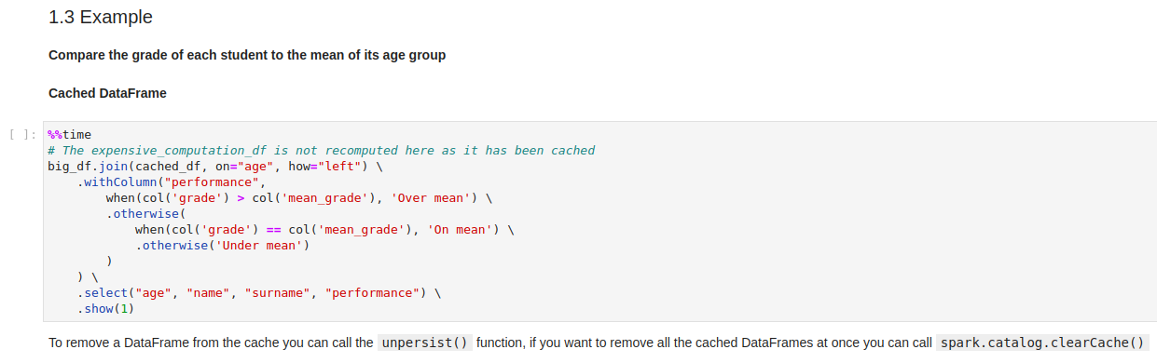
Spark Performance Tuning
Let’s test all this optimizations with real examples
Jump back into Jupyter Lab to see how…
Open the Jupyter Notebook 04_Spark_Performance_Tuning.ipynb

Slide 34
7. HDFS

Slide 35

HDFS
What is HDFS?
The Hadoop distributed file system (HDFS) is a distributed, scalable, and portable file system written in Java for the Hadoop framework.
HDFS is designed to scale up from a single server to thousands of machines, with each offering local computation and storage.
Key features
Block-based Structure: Data in HDFS is stored in blocks (commonly 128 MB or 256 MB in size), and these blocks are distributed across the cluster. Each block is replicated multiple times (usually three) to handle hardware failure.
Fault Tolerance: Due to its block replication mechanism, HDFS is fault-tolerant. If a block or node fails, data can be recovered from another node where the block is replicated.
Write-once, Read-many Model: HDFS is primarily designed for large data sets and supports a write-once and read-many times paradigm. This model simplifies data coherency issues.

Slide 36
HDFS
Key features
High Throughput & Scalability: HDFS is designed to provide high throughput for data access and can easily scale out by adding more machines to the cluster.
Data Locality: One of the primary objectives of HDFS is to store data on the compute nodes so that processing tasks can run on nodes where data is locally stored. This minimizes the data transfer across the cluster and increases processing speed.
Simple Coherency Model: Once written, data/files can't be modified, only appended to. This eliminates potential issues that can arise from multiple sources trying to update a file simultaneously.
Large Data Sets: HDFS is designed to handle very large files, making it suitable for big data processing tasks.
Streaming Data Access: HDFS is optimized for streaming access of its datasets, meaning it's best suited for applications that require sequential access, rather than random access.
Integration with Hadoop Ecosystem: HDFS is deeply integrated with various components of the Hadoop ecosystem like MapReduce, YARN, Hive, Pig, and others. This allows for efficient processing and management of big data.

Slide 37

HDFS
HDFS Architecture

Slide 38
HDFS
HDFS Architecture
NameNode (Master Server): Manages and maintains the metadata of HDFS. Does not store the actual data but maintains the file system tree and the metadata for all the files and directories in the system. This metadata is stored in RAM for fast access.
Secondary NameNode: Performs housekeeping functions for the NameNode. It periodically merges the changes (edits) with the filesystem image (fsimage) and produces an updated version of fsimage. This helps in preventing the edit log on the NameNode from becoming excessively large.
DataNode (Slave Server): Stores and manages the actual data blocks of HDFS. Creates, deletes, and replicates blocks based on instructions from the NameNode. Periodically sends a heartbeat to the NameNode to signal it's alive. Along with the heartbeat, it sends a block report, which lists all the blocks on a DataNode.
Block: The fundamental storage unit of HDFS. Each file is divided into blocks of a fixed size (default is 128MB or 256MB). These blocks are distributed across the cluster, and multiple copies (replicas) of each block are maintained to ensure fault tolerance.
Client: Interacts with HDFS. When an HDFS client wants to read a file, it communicates with the NameNode to determine the block locations. The client then contacts the respective DataNodes to read or write data.

Slide 39
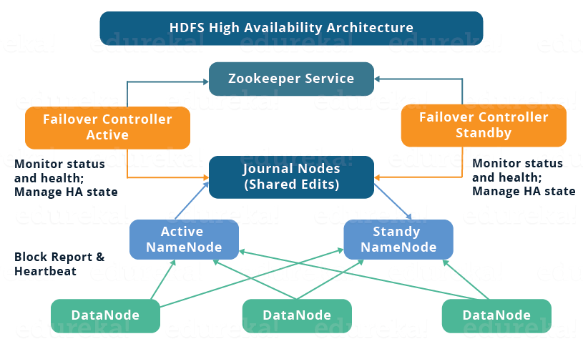
HDFS
HDFS High Availability Architecture, the one used in Stratio
Standby NameNode: Modern Hadoop deployments use the HA (High Availability) architecture, replacing the traditional Secondary NameNode with a Standby NameNode. It performs the same functions as the Secondary NameNode while acting as a backup to the Active NameNode, prepared to take over its functions without any loss of data or significant downtime in case of failure (Readiness for Failover).
JournalNode: For the system to effectively switch from the Active to the Standby NameNode during failures without data loss or discrepancy, the metadata changes made by the Active NameNode need to be continuously synchronized with the Standby NameNode. This is where JournalNodes come into the picture.
Apache ZooKeeper: is a distributed coordination service. It helps in managing and coordinating the two NameNodes, maintaining configuration information, naming, providing distributed synchronization, and group services. In essence, controls that the system can automatically recover from NameNode failures, ensuring high availability and preventing split-brain scenarios.

Slide 40
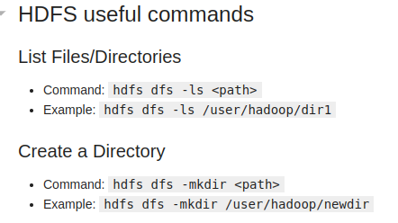
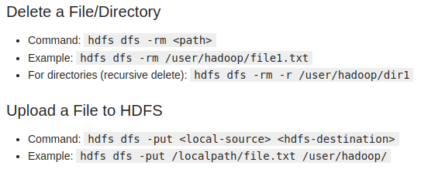
HDFS
Want to have a cheatsheet with useful HDFS commands
Jump back into Jupyter Lab and…
Open the Jupyter Notebook 05_HDFS.ipynb

Slide 41
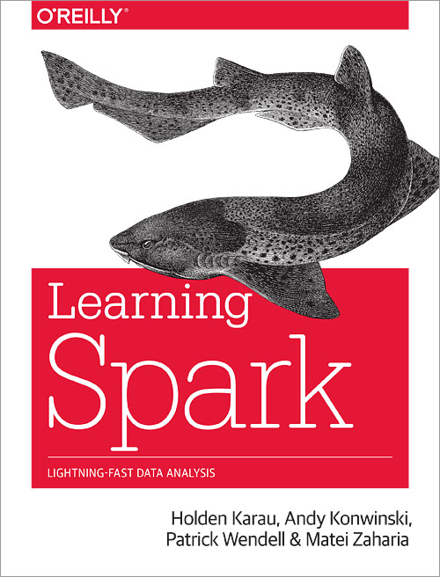
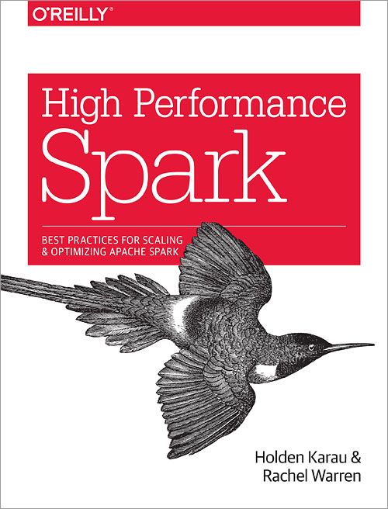
Books...
In case you want to dive deeper into Spark…

Slide 42
amarchan@stratio.com

